Slide 1
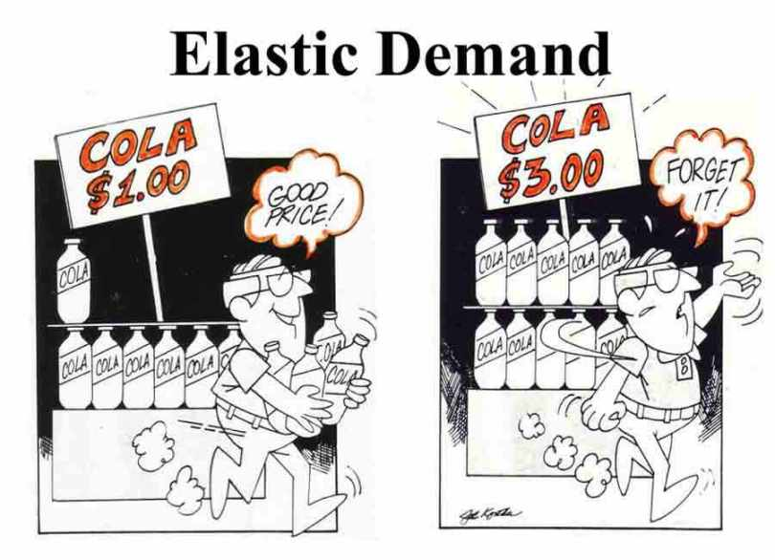
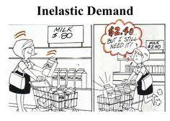
Elasticity and its Application

Slide 2
Equilibrium of supply and demand
Price of
Ice-Cream
Cones
Supply
$3.00
2.50
Equilibrium
price
Equilibrium
2.00
1.50
1.00
Equilibrium
quantity
Demand
0.50
0
1
2
3
4
5
6
7
8
9
10
11
12
Quantity of Ice-Cream Cones

Slide 3

In this chapter, look for the answers to these questions:
What is elasticity? What kinds of issues can elasticity help us to understand?
What is the price elasticity of demand?
How is it related to the demand curve?
How is it related to revenue & expenditure?
What are the income and cross-price elasticities of demand?

Slide 4
Elasticity
Elasticity measures sensitivity or responsiveness.
Elasticity measures how much one variable responds to changes in another variable
is a measure of how much buyers and sellers respond to changes in market conditions

Slide 5
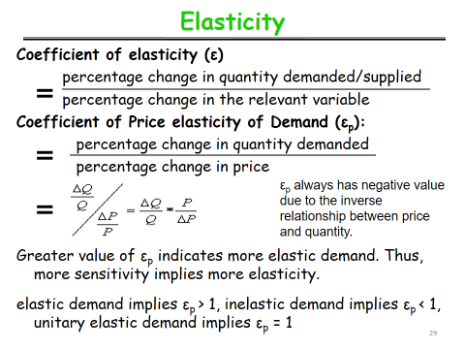
ELASTICITY AND ITS APPLICATION

Slide 6
Elasticity of Demand
Price elasticity of demand:
- measures how much quantity demanded of a product changes in response to a given change in its own price.
Cross price elasticity of demand:
- measures responsiveness of quantity demanded to changes in the price of related goods (both substitutes and complements).
Income elasticity of demand:
- measures responsiveness of quantity demanded to changes in incomes of the people.

Slide 7
What determines price elasticity?
0
To learn the determinants of price elasticity,
we look at a series of examples.
Each compares two common goods.
In each example:
  Suppose the prices of both goods rise by 20%.
  The good for which Q^{d} falls the most (in percent) has the highest price elasticity of demand.
  Which good is it? Why?
  What lesson does the example teach us about the determinants of the price elasticity of demand?
ELASTICITY AND ITS APPLICATION

Slide 8
EXAMPLE 1:
Pepsi vs. Edible salt
0
The prices of both of these goods rise by 20%.
For which good does Q^{d} drop the most? Why?
  Pepsi has close substitutes (e.g., Thumbs up), so buyers can easily switch if the price rises.
  Salt has no close substitutes. So consumers would probably not buy much less if its price rises.
Lesson: Price elasticity is higher when close substitutes are available.
ELASTICITY AND ITS APPLICATION

Slide 9
EXAMPLE 2:
“Jeans” vs. “Clothing”
0
The prices of both goods rise by 20%.
For which good does Q^{d} drop the most? Why?
  For a narrowly defined good such as jeans, there may be many substitutes (formal pant, track pant etc)
  There are fewer substitutes available for broadly defined goods
  (There aren’t too many substitutes for clothing)
Lesson: Price elasticity is higher for narrowly defined goods than broadly defined ones.
ELASTICITY AND ITS APPLICATION

Slide 10
EXAMPLE 3:
Insulin vs. Cruise vacation
0
The prices of both of these goods rise by 20%.
For which good does Q^{d} drop the most? Why?
  To millions of diabetics, insulin is a necessity.
  A rise in its price would cause little or no decrease in demand.
  A cruise is a luxury. If the price rises, some people will forego it.
Lesson: Price elasticity is higher for luxuries than for necessities.
ELASTICITY AND ITS APPLICATION

Slide 11
EXAMPLE 4:
Cooking gas in the Short Run vs. Cooking gas in the Long Run -- Urban areas
0
The price of gasoline rises 20%. Does Q^{d} drop more in the short run or the long run? Why?
  In the short run, people will continue to use in absence of close substitutes --- inelastic
  In the long run, good substitutes like solar energy, electric chulha may come --- elastic
Lesson: Price elasticity is higher in the
long run than the short run.
ELASTICITY AND ITS APPLICATION

Slide 12
The Determinants of Price Elasticity:
A Summary
0
The price elasticity of demand depends on:
  the extent to which close substitutes are available
  whether the good is a necessity or a luxury
  how broadly or narrowly the good is defined
  the time horizon – elasticity is higher in the long run than the short run
ELASTICITY AND ITS APPLICATION

Slide 13
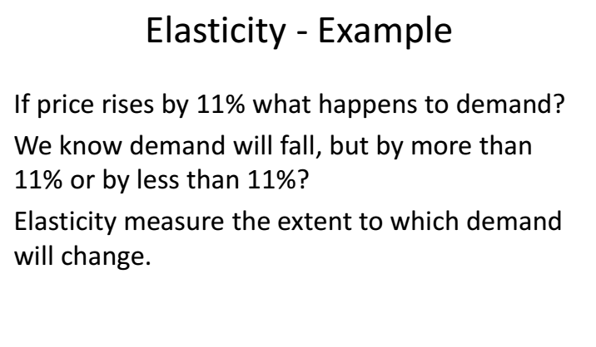
Price Elasticity of Demand
0
ELASTICITY AND ITS APPLICATION

Slide 14
Price Elasticity of Demand
0
Price elasticity of demand
Percentage change in Q^{d}
=
Percentage change in P
Price elasticity of demand measures how much Q^{d} responds to a change in P.
Loosely speaking, it measures the price-sensitivity of buyers’ demand.
ELASTICITY AND ITS APPLICATION

Slide 15
Price Elasticity of Demand
0
Price elasticity of demand
Percentage change in Q^{d}
=
Percentage change in P
P
Example:
P rises by 10%
Price elasticity
of demand equals
P₂
P₁
D
15%
Q
= 1.5
Q₂
Q₁
10%
Q falls by 15%
ELASTICITY AND ITS APPLICATION

Slide 16
Price Elasticity of Demand
0
Price elasticity of demand
Percentage change in Q^{d}
=
Percentage change in P
P
Along a D curve, P and Q move in opposite directions, which would make price elasticity negative.
We will drop the minus sign and report all price elasticities as
positive numbers.
P₂
P₁
D
Q
Q₂
Q₁
ELASTICITY AND ITS APPLICATION

Slide 17
Calculating Percentage Changes
0
Standard method
of computing the percentage (%) change:
Demand for a good
New value – Old value
P
x 100%
Old value
B
$250
A
Going from A to B,
the % change in P equals
$200
D
($250–$200)/$200 x 100%
= 25%
Q
8
12
ELASTICITY AND ITS APPLICATION

Slide 18
Calculating Percentage Changes
0
Problem:
The standard method gives different answers depending on where you start.
Demand for a good
P
From A to B,
P rises 25%, Q falls 33%,
elasticity = 33/25 = 1.33
From B to A,
P falls 20%, Q rises 50%, elasticity = 50/20 = 2.50
B
$250
A
$200
D
Q
8
12
ELASTICITY AND ITS APPLICATION

Slide 19
Calculating Percentage Changes
0
So, we instead use the midpoint method:
New value – Old value
x 100%
midpoint
The midpoint is the number halfway between the start & end values, the average of those values.
It doesn’t matter which value you use as the “start” and which as the “end” – you get the same answer either way!
ELASTICITY AND ITS APPLICATION

Slide 20
Calculating Percentage Changes
0
Using the midpoint method, the % change
in P equals
$250 – $200
x 100%
= 22.2%
$225
The % change in Q equals
12 – 8
x 100%
= 40.0%
10
The price elasticity of demand equals
40/22.2 = 1.8
ELASTICITY AND ITS APPLICATION

Slide 21

QUESTION 1
Calculate an elasticity
Use the following
information to
calculate the
price elasticity
of demand
for hotel rooms:
if P = $70, Q^{d} = 5000
if P = $90, Q^{d} = 3000

Slide 22
A C T I V E L E A R N I N G 1
Answers
Use midpoint method to calculate
% change in Q^{d}
(5000 – 3000)/4000 = 50%
% change in P
($90 – $70)/$80 = 25%
The price elasticity of demand equals
50%
= 2.0
25%

Slide 23
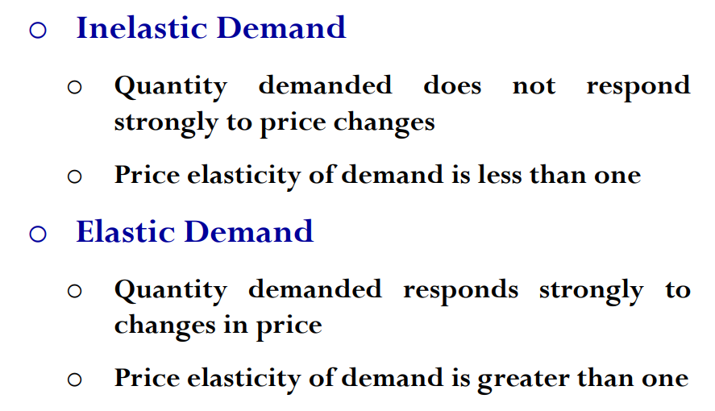

Slide 24
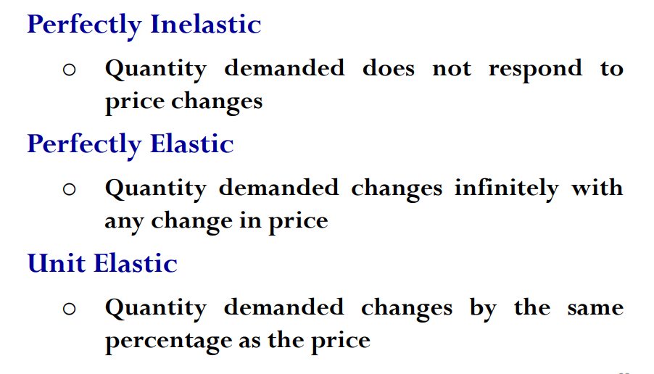

Slide 25
The Variety of Demand Curves
0
The price elasticity of demand is closely related to the slope of the demand curve.
Rule of thumb:
The flatter the curve, the bigger the elasticity.
The steeper the curve, the smaller the elasticity.
Five different classifications of D curves.…
ELASTICITY AND ITS APPLICATION

Slide 26
“Perfectly inelastic demand” (one extreme case)
0
Price elasticity
of demand
% change in Q
0%
=
=
= 0
% change in P
10%
D curve:
P
D
vertical
P₁
Consumers’
price sensitivity:
P₂
none
P falls by 10%
Q
Elasticity:
Q₁
0
Q changes
by 0%
ELASTICITY AND ITS APPLICATION

Slide 27
“Inelastic demand”
0
Price elasticity
of demand
% change in Q
< 10%
=
=
< 1
% change in P
10%
D curve:
P
relatively steep
P₁
Consumers’
price sensitivity:
P₂
relatively low
D
P falls by 10%
Q
Elasticity:
Q₁
Q₂
< 1
Q rises less than 10%
ELASTICITY AND ITS APPLICATION

Slide 28
“Unit elastic demand”
0
Price elasticity
of demand
% change in Q
10%
=
=
= 1
% change in P
10%
D curve:
P
intermediate slope
P₁
Consumers’
price sensitivity:
P₂
intermediate
D
P falls by 10%
Q
Elasticity:
Q₁
Q₂
1
Q rises by 10%
ELASTICITY AND ITS APPLICATION

Slide 29
“Elastic demand”
0
Price elasticity
of demand
% change in Q
> 10%
=
=
> 1
% change in P
10%
D curve:
P
relatively flat
P₁
Consumers’
price sensitivity:
P₂
D
relatively high
P falls by 10%
Q
Elasticity:
Q₁
Q₂
> 1
Q rises more than 10%
ELASTICITY AND ITS APPLICATION

Slide 30
“Perfectly elastic demand” (the other extreme)
0
Price elasticity
of demand
% change in Q
any %
=
=
= infinity
% change in P
0%
D curve:
P
horizontal
P₂ =
P₁
D
Consumers’
price sensitivity:
extreme
P changes by 0%
Q
Elasticity:
Q₁
Q₂
infinity
Q changes
by any %
ELASTICITY AND ITS APPLICATION

Slide 31
Price Elasticity and Total Revenue
0
Continuing our scenario, if you raise your price
from $200 to $250, would your revenue rise or fall?
Revenue = P x Q
Does raising price bring in more revenue?
  Higher P means more revenue on each unit
  you sell.
  But you sell fewer units (lower Q), due to Law of Demand.
Which of these two effects is bigger?
It depends on the price elasticity of demand.
ELASTICITY AND ITS APPLICATION

Slide 32
Price Elasticity and Total Revenue
0
Price elasticity of demand
Percentage change in Q
=
Percentage change in P
Revenue = P x Q
If demand is elastic, then
  price elast. of demand > 1
  % change in Q > % change in P
The fall in revenue from lower Q is greater
than the increase in revenue from higher P,
so revenue falls.
ELASTICITY AND ITS APPLICATION

Slide 33
Price Elasticity and Total Revenue
0
Elastic demand
(elasticity = 1.3)
increased revenue due to higher P
P
lost revenue due to lower Q
If P = $200,
Q = 12 and revenue = $2400.
$250
$200
If P = $250,
Q = 8 and
revenue = $2000.
D
When D is elastic,
a price increase
causes revenue to fall.
Q
8
12
ELASTICITY AND ITS APPLICATION

Slide 34
Price Elasticity and Total Revenue
0
Price elasticity of demand
Percentage change in Q
=
Percentage change in P
Revenue = P x Q
If demand is inelastic, then
  price elast. of demand < 1
  % change in Q < % change in P
The fall in revenue from lower Q is smaller than the increase in revenue from higher P, so revenue rises
In our example, suppose that Q only falls to 10 (instead of 8) when you raise your price to $250
ELASTICITY AND ITS APPLICATION

Slide 35
Price Elasticity and Total Revenue
0
Now, demand is inelastic:
elasticity = 0.82
increased revenue due to higher P
P
lost revenue due to lower Q
If P = $200,
Q = 12 and revenue = $2400.
$250
If P = $250,
Q = 10 and
revenue = $2500.
$200
D
When D is inelastic,
a price increase
causes revenue to rise.
Q
10
12
ELASTICITY AND ITS APPLICATION

Slide 36
Elasticity and revenue
If demand is . . . | Then . . .
Elastic | A Price increase reduces Total Revenue & a Price decrease raises Total Revenue
Unitary | A change in Price does not affect Total Revenue
Inelastic | A Price increase increases Total Revenue & a Price decrease reduces Total Revenue

Slide 37
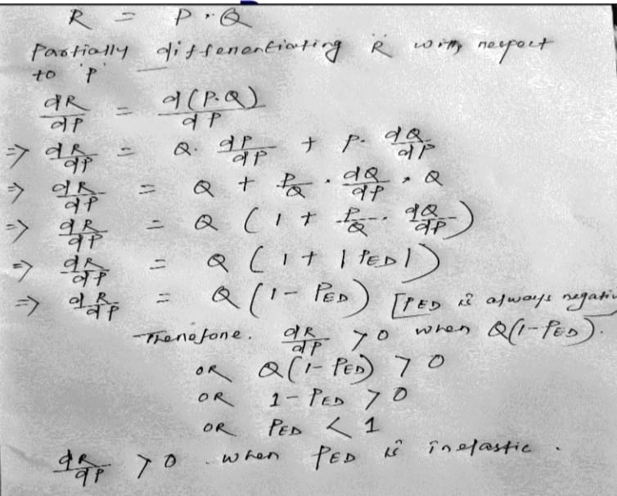

Slide 38
Other Elasticities
Income elasticity of demand: measures the response of Q^{d} to a change in consumer income
Income elasticity of demand
Percent change in Q^{d}
=
Percent change in income
Recall : An increase in income causes an increase in demand for a normal good.
Hence, for normal goods, income elasticity > 0.
For inferior goods, income elasticity < 0.
ELASTICITY AND ITS APPLICATION

Slide 39
Other Elasticities
Cross-price elasticity of demand:
measures the response of demand for one good to changes in the price of another good
Cross-price elast.
of demand
% change in Q^{d} for good 1
=
% change in price of good 2
For substitutes, cross-price elasticity > 0
(e.g., an increase in price of tea causes an increase in demand for coffee)
For complements, cross-price elasticity < 0
(e.g., an increase in price of petrol causes decrease in demand for car)
ELASTICITY AND ITS APPLICATION

Slide 40
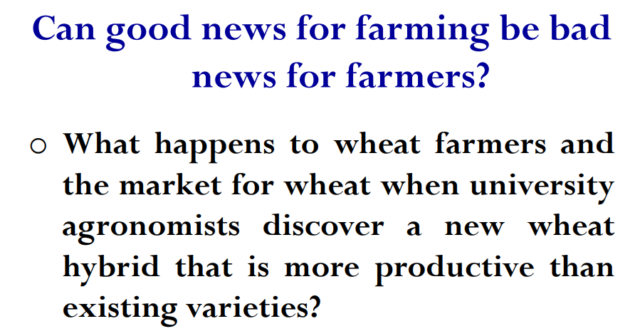

Slide 41
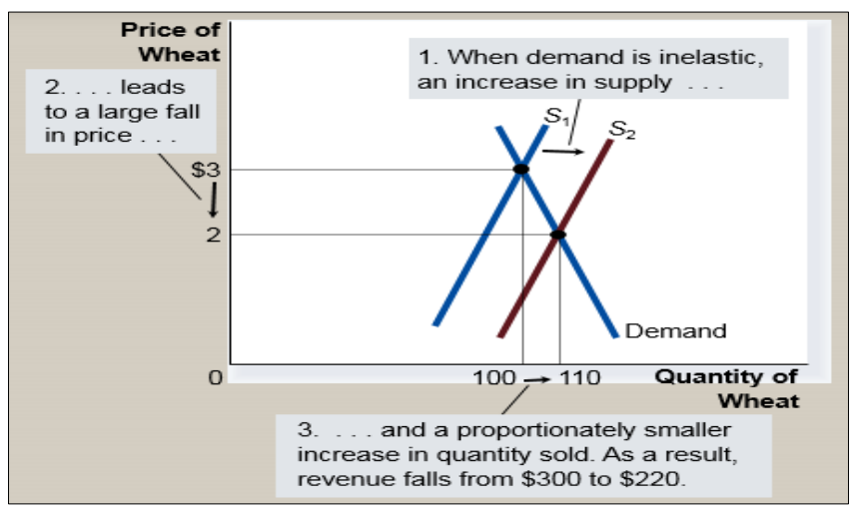

Slide 42
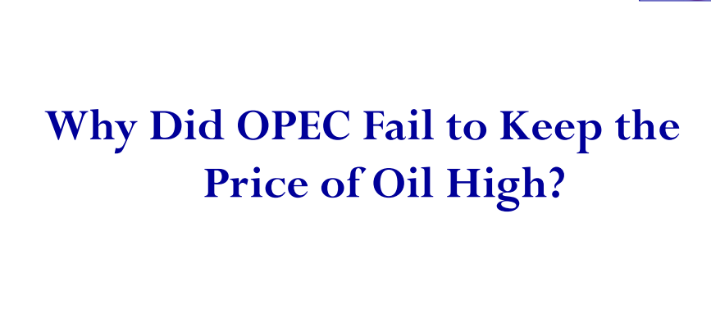

Slide 43
Examine the significance of PED for government in relation to indirect taxes
The imposition of an indirect tax (tax on a good shifts supply curve upwards by the amount of the tax) usually means that the price increases.
However, the amount of the price increase will depend on the price elasticity of demand PED. Compare Figures 1 and 2 to see the difference.

Slide 44
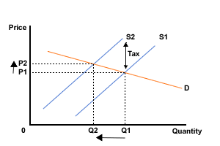
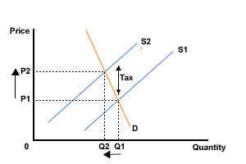
Examine the significance of PED for government in relation to indirect taxes
Figure 1 Tax imposed on a good with elastic demand
Figure 2 Tax imposed on a good with inelastic demand

Slide 45
1. If you aimed as a government solely to reduce the consumption of the good, which type of good would you be taxing?
a) Elastic demand
b) Inelastic demand
2. If you aimed as a government to tax goods simply to raise tax revenue, which type of good would you tax?
a) Elastic demand
b) Inelastic demand

Slide 46
CHAPTER SUMMARY
Elasticity measures the responsiveness of
Q^{d} or Q^{s} to one of its determinants.
Price elasticity of demand equals percentage change in Q^{d} divided by percentage change in P.
When it’s less than one, demand is “inelastic.” When greater than one, demand is “elastic.”
When demand is inelastic, total revenue rises when price rises. When demand is elastic, total revenue falls when price rises.

Slide 47
CHAPTER SUMMARY
Demand is less elastic in the short run,
for necessities, for broadly defined goods,
or for goods with few close substitutes.
Price elasticity of supply equals percentage change in Q^{s} divided by percentage change in P.
When it’s less than one, supply is “inelastic.” When greater than one, supply is “elastic.”
Price elasticity of supply is greater in the long run than in the short run.

Slide 48
CHAPTER SUMMARY
The income elasticity of demand measures how much quantity demanded responds to changes in buyers’ incomes.
The cross-price elasticity of demand measures how much demand for one good responds to changes in the price of another good.

